Slide 1

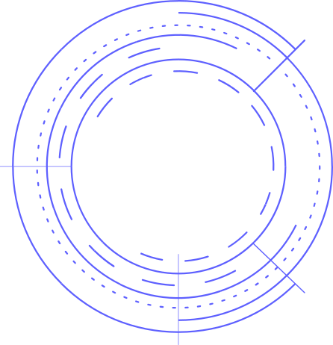


Image Clustering
+
Retrieval System
SUMAMA SULEMAN (22F-BSAI-12)
M.KAIF ABDULLAH (22F-BSAI-19)
MUZNA SIDDIQUI (22F-BSAI-37)
MAHEEN SIDDIQUI (22F-BSAI-49)

Slide 2



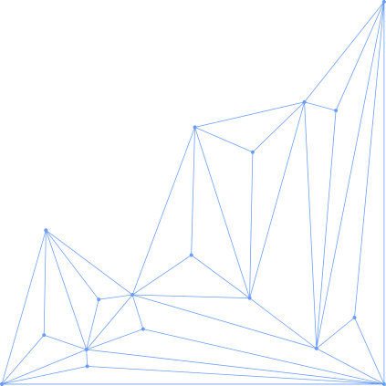
INTRODUCTION
This project focuses on developing an image retrieval and clustering system using deep learning, where a pre-trained ResNet50 Convolutional Neural Network is used to extract meaningful image features automatically.

Slide 3
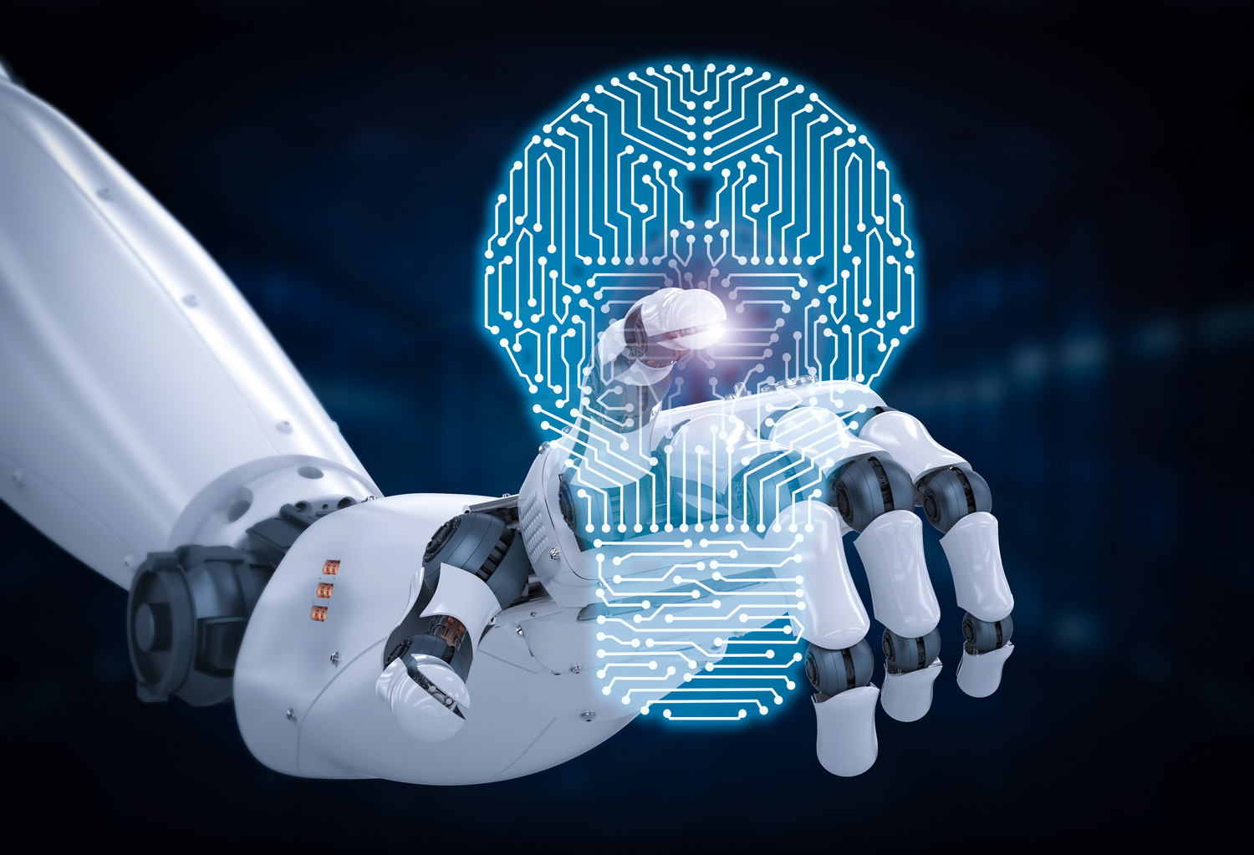

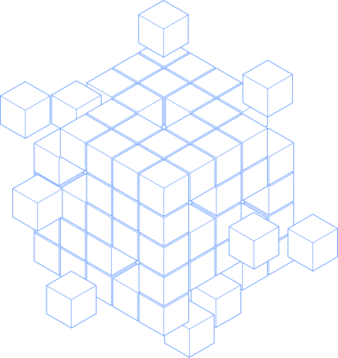


OBJECTIVES OF THE PROJECT
The key objectives of this project are:
To extract deep feature representations from images
To analyze similarity between images using cosine similarity
To cluster visually similar images into groups
To implement an interactive image retrieval system using Streamlit
To understand the practical application of pre-trained deep learning models

Slide 4
DATASET DESCRIPTION
The dataset consists of multiple images arranged in class-wise folders, where each folder represents a specific category.
Preprocessing steps:
01
Images were extracted from a ZIP file
02
All images were resized to a fixed size.
03
Dataset balancing was applied to reduce class bias

Slide 5

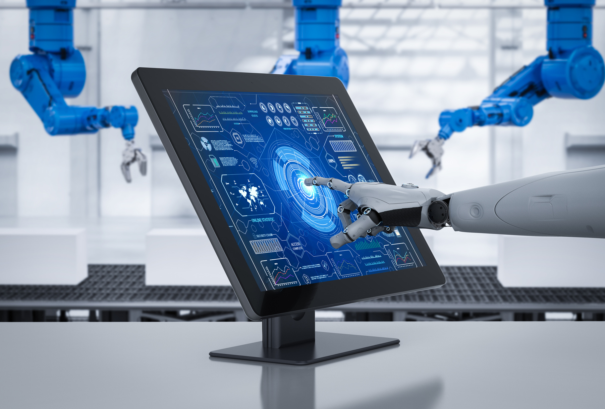
TOOLS AND TECHNOLOGIES USED
The following tools and technologies were used:
1
Python
2
TensorFlow and Keras
We is used as the primary programming language for system development
provide the framework for deep learning models
3
ResNet50
4
Numpy
is utilized as a pre-trained CNN to extract deep image features
supports efficient numerical computation and data handling

Slide 6
TOOLS AND TECHNOLOGIES USED
The following tools and technologies were used:
K-Means and Hierarchical Clustering
Cosine Similarity
5
6
algorithms are applied for image grouping
is used to compute similarity between image embeddings
7
Matplotlib
8
Streamlit
assists in visual analysis and plotting results
is used to design a user-friendly and interactive web application

Slide 7

FEATURE EXTRACTION USING ResNet50
A pre-trained ResNet50 model, trained on the ImageNet dataset, was used as a feature extractor.
1
Classification Layers Removed
The original classification layers of the ResNet50 model were removed to focus only on extracting meaningful features from images.
Global Average Pooling Applied
2
Global Average Pooling summarized the spatial information into a single vector.
Image Converted to Embedding
3
Each image became a 2048-dimensional feature vector, called an embedding, capturing key visual and semantic information.

Slide 8

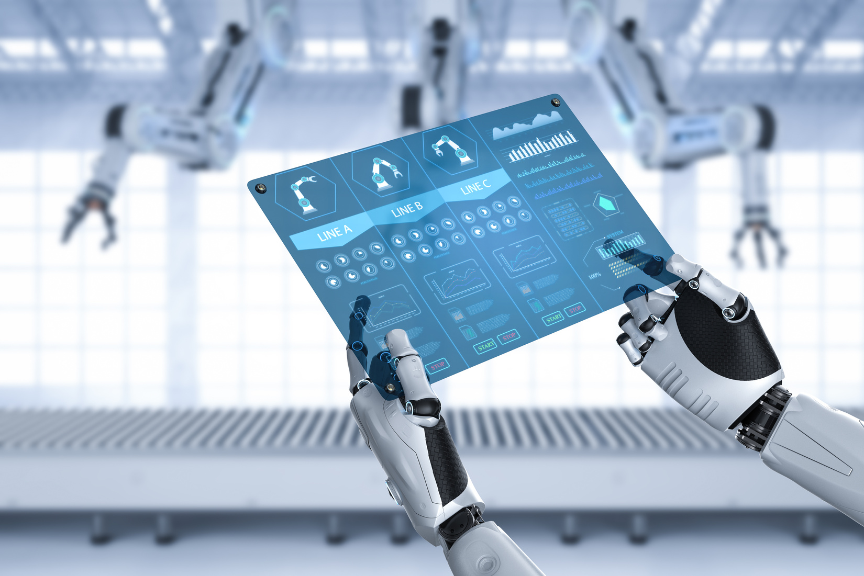
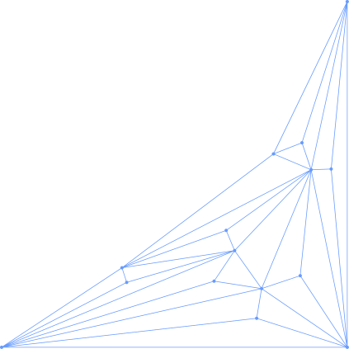

FEATURE NORMALIZAION
The extracted embeddings were normalized using StandardScaler.
Normalization helps to:
1
2
3
Maintain a Uniform Feature Scale
Improve Clustering Accuracy
Enhance Similarity Comparison Results
Ensures all features are on the same scale for consistent representation.
Helps clustering algorithms group similar images more effectively.
Leads to more reliable results when comparing image embeddings.

Slide 9


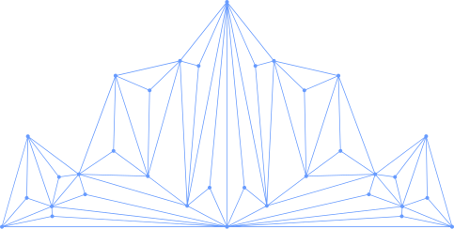

DIMENSIONALITY REDUCTION (PCA)
Since the embeddings are high-dimensional, Principal Component Analysis (PCA) was applied.
01
Dimensionality Reduction
PCA reduces the high-dimensional feature vectors to just 2 dimensions, making the data easier to visualize.
02
Visualization
It is used primarily for visualization, allowing us to see patterns and relationships between images.
03
Cluster Insights
PCA helps in understanding the distribution of clusters and how similar or different the images are within the feature space.

Slide 10


CLUSTERING TECHNIQUES
Two clustering techniques were implemented:
K-Means Clustering
K-Means clustering groups images into a predefined number of clusters. Images with similar features are placed in the same cluster, making it easier to analyze and organize large image datasets.
Hierarchical Clustering
Hierarchical clustering builds a tree-like structure that shows relationships between images. It is useful for analyzing similarity at different levels, allowing a more detailed view of how images are related.

Slide 11
IMAGE RETRIEVAL PROCESS
The image retrieval process works as follows:
1
Query Image Upload
2
Feature Extraction
A query image is uploaded into the system to find similar images from the dataset.
The feature embedding of the uploaded image is extracted using the pre-trained ResNet50 model.
3
Similarity Computation
4
Top-K Retrieval
Cosine similarity is calculated between the query image embedding and all dataset embeddings to measure how similar they are.
The Top-K most similar images are retrieved based on similarity scores and displayed to the user.

Slide 12
CODE IMPLEMENTATION

Slide 13
SUPPORT VECTOR SYSTEM (SVM)
A Support Vector Machine (SVM) was used for image classification.
SVM allows accurate classification without training a deep model from scratch.
1
Feature Input
Deep features extracted from ResNet50 were used as input for classification.
Decision Boundary
2
SVM finds an optimal decision boundary between different classes.
High-Dimensional Performance
3
SVM performs well on high-dimensional data, making it suitable for deep embeddings.

Slide 14
ROLE OF SVM IN THE SYSTEM
A The role of SVM in this project includes:
01
Image Classification
Classifying images based on the extracted embeddings allows the system to make predictions using meaningful feature representations.
02
Accuracy and Efficiency
The approach improves classification accuracy while keeping computational cost minimal.
03
Data Handling and Performance
vIt handles limited labeled data efficiently and enhances the overall performance of the system.

Slide 15
RESULTS AND OBSERVATIONS
The following results were observed:
ResNet50 extracted meaningful image features
Similar images were correctly clustered
SVM achieved accurate classification results
Cosine similarity provided precise image retrieval
The system was efficient and user-friendly

Slide 16
CONCLUSION
This project successfully demonstrates the use of deep learning for image retrieval and clustering.
ResNet50 was used for feature extraction
Clustering grouped similar images effectively
SVM improved classification accuracy
The system is scalable and suitable for real-world applications

Slide 17


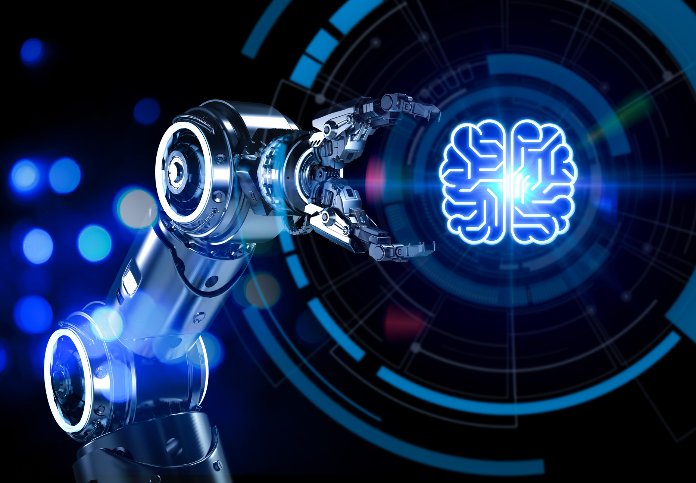
THANKYOU!

